Slide 1
E-Library Management
By Yogeshwaran and Bharath

Slide 2
Overview
It is an E-Library management application where we can search the book and open the book in the pdf format and we can read the book .
The Admin and manage all the books in the database and he can add the books and remove the books if he want

Slide 3





Technologies

Slide 4
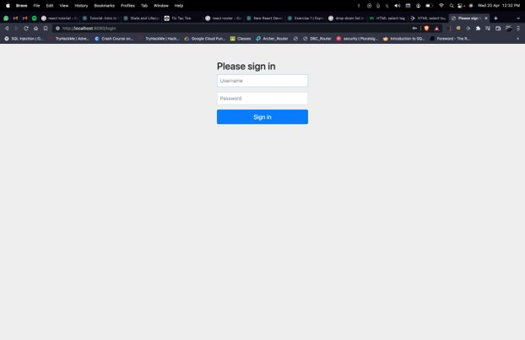
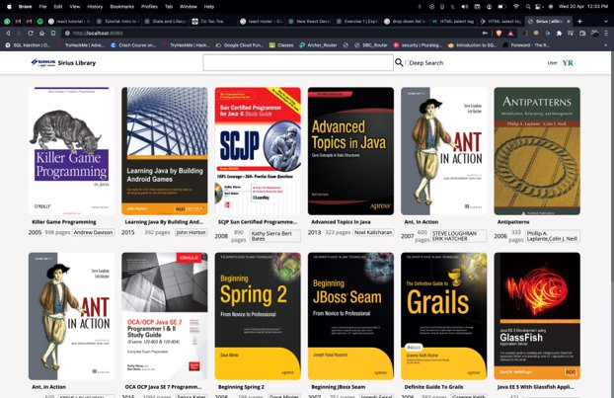
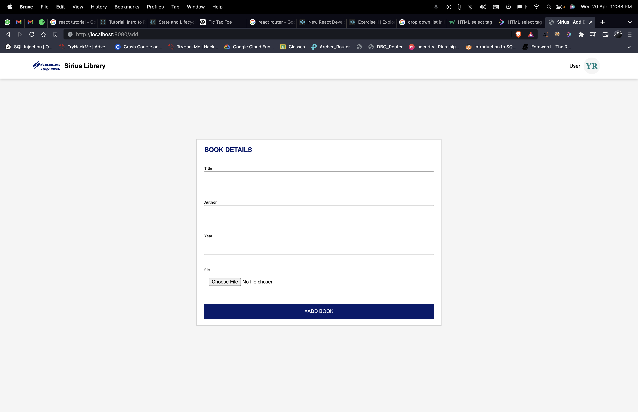
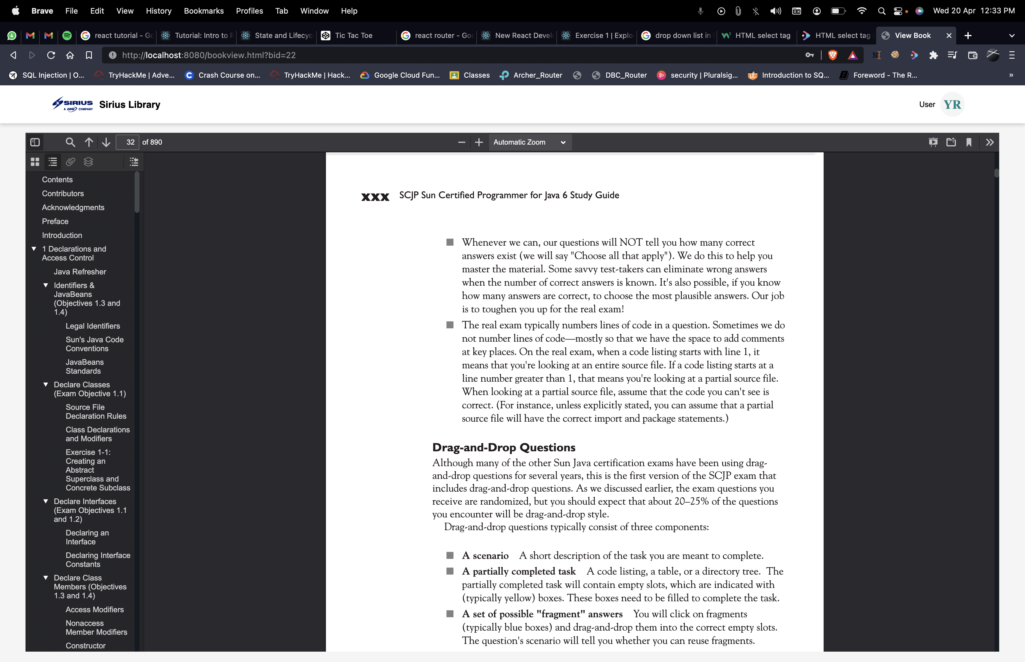
PROJECT FLOW
Login Page
Home Page
Add Books Page
(admins only)
View Books

Slide 5
REPOSITORY and video links
GitHub Link
https://github.com/yogeshraja/elibrary
Video Link
https://fluvid.com/videos/detail/7R-4LiOd-YfRVqXka

Slide 6


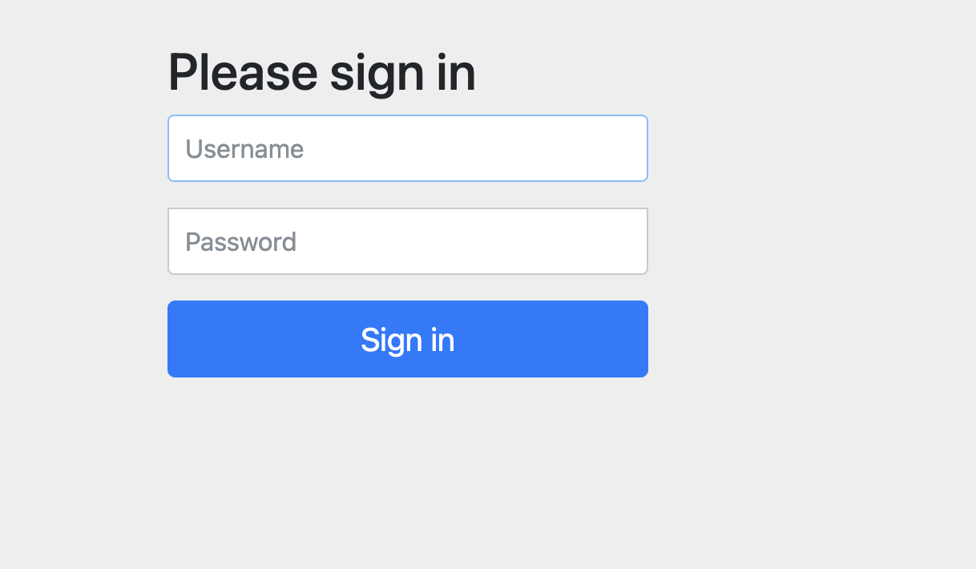
Login
This is a basic login page with which the users and admin can login and use our application.
When the user logged in he can view the available books in our application

Slide 7
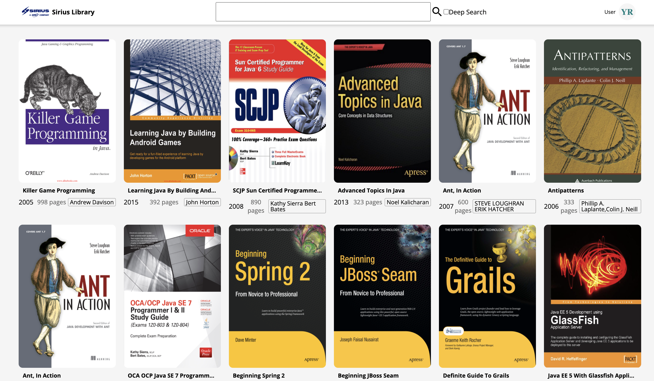
Home page
After Logging in the users will land in the home page, where all the available books in the library will be displayed

Slide 8
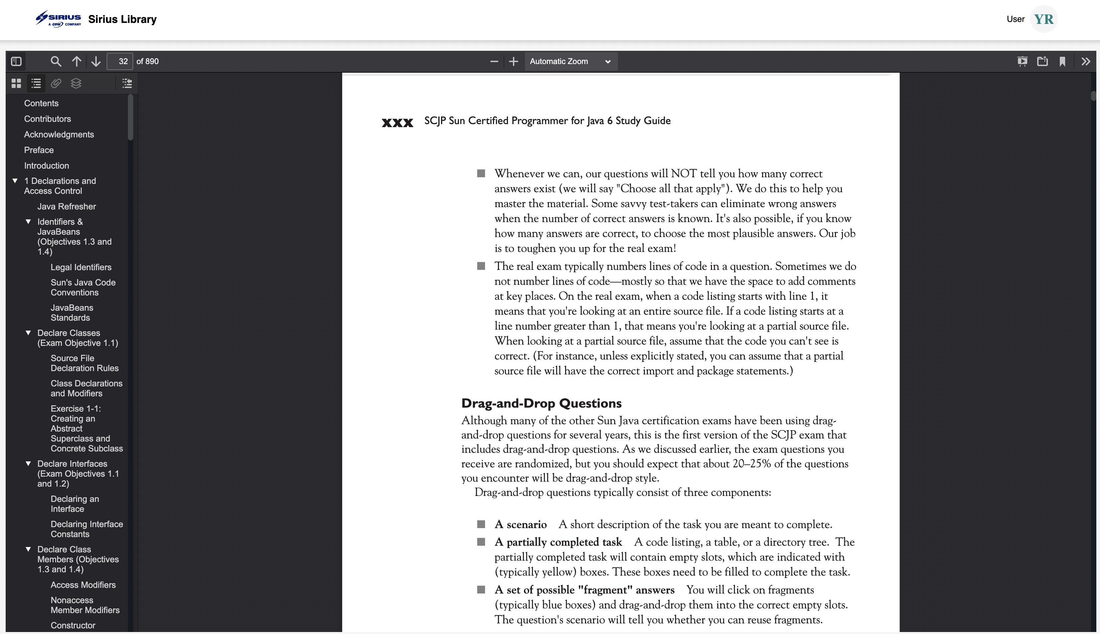
Book View Page
When the user clicks the book, then the pdf of that book will be displayed

Slide 9
Add book page
In this page the Admin can add the book and this book will be displayed in the home page of our application.

Slide 10
THANK YOU

